Slide 1
Quacho basic board modification
Description of the preparation process to make the quacho basic board suitable for the 2.4 GHz RF shield

Slide 2
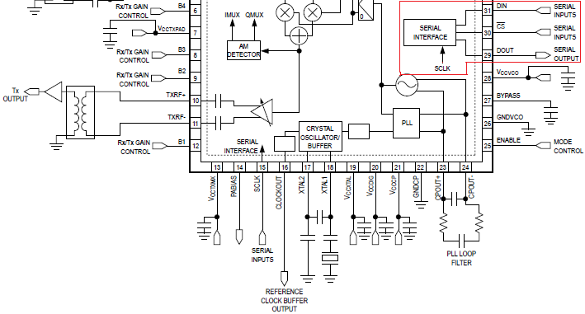
Functional Description
The RF shield will expand the functionalities of the Quacho Project making it a complete sdr transceiver device working in the 2.4GHz Band.
The transceiver IC allocated in the rf shield receives commands throug SPI.
To make the connection between the transceiver (rf shield) and the MCU (quacho basic board) three options are available from the MCU (ATSAM3S2C):
-SPI interface
-USART0.
-USART1
The spi interface of the max 2837 can be seen inside the red figure

Slide 3
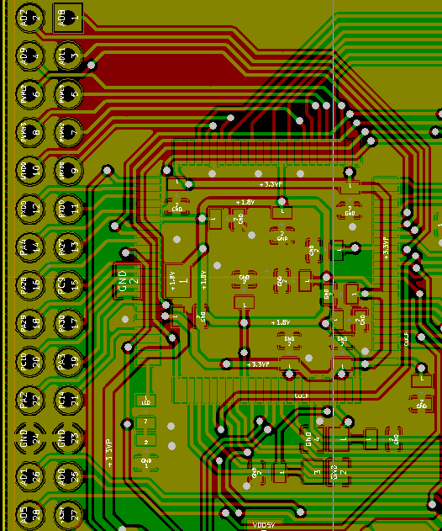
Connection objective
Our objective is to connect a full spi communication channel routing the four lines from the mcu (URXD, UTXD, SCK and CS), to the universal 2*14 connector nearest to the chip.
Once the lines are routed, the spi channel can be accesed from the rf shield above.
Detail of the quacho basic board showing the 2*14 connector and the MCU chip besides it.

Slide 4
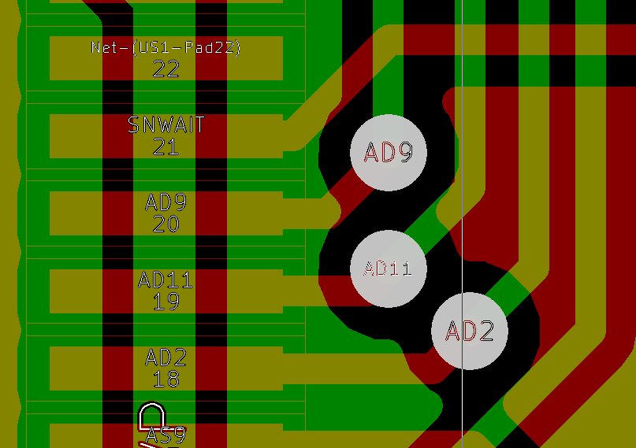
Serial Interface Selection Analysis
In order to use a line from a specific MCU peripheral module, the physical pin must be routed to some of the lines in the universal 2*14 connector cammunicating the boards.
The Quacho board was analyzed to select the serial interface, the following facts were found:
-MISO line from SPI is associated to the 41st pin from the MCU; this pin does have a route to the connector, due to that the spi module will not be used, the usart1 module will be used instead.
-Clock line from USART1 (22nd pin) was not routed either.
The picture shows how the clock line (22nd pin) from USART1 is not routed.

Slide 5
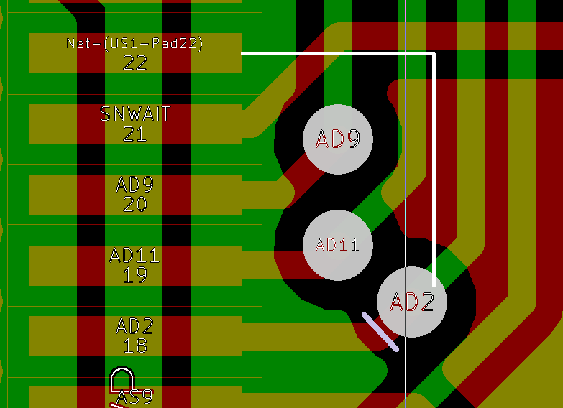
Proposed Hardware Modification
In order to Access the USART clock line a minor modification is the solution proposed to connect the needed communication lines to the 2*14 connector on the board.
The White line showed on the picture on the right shows the place where a short caliber copper wire piece will be soldered to use the AD2 route establish connection between the 22nd pin an the universal 2*14 connector.
The light purple line shows the place where the AD2 route has to be cut disconnecting the MCU´s 18th pin .

Slide 6
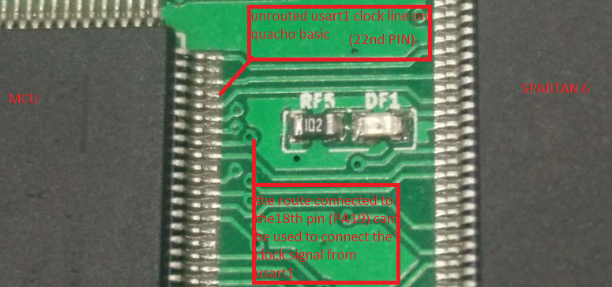
Outcome of modification
Quacho Basic board before the modification

Slide 7
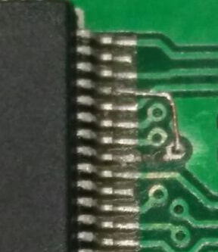
Outcome of modification
Quacho Basic board after the modification
After this procedure, all USART1 lines are accesible from the universal connector and can be used at the rf shield.

